Slide 1

C# European Council Voting Calculator Replica
Zak Hargreaves, Jacob Marshall & Lewis Robinson

Slide 2

Version control tools
Every time the code was changed the records were updated and commented with what the change was. This allowed us to revert back to selected files incase of any errors (EG: File Corruption) This type of version control is called a Distributed Version Control System (DVS)

Slide 3
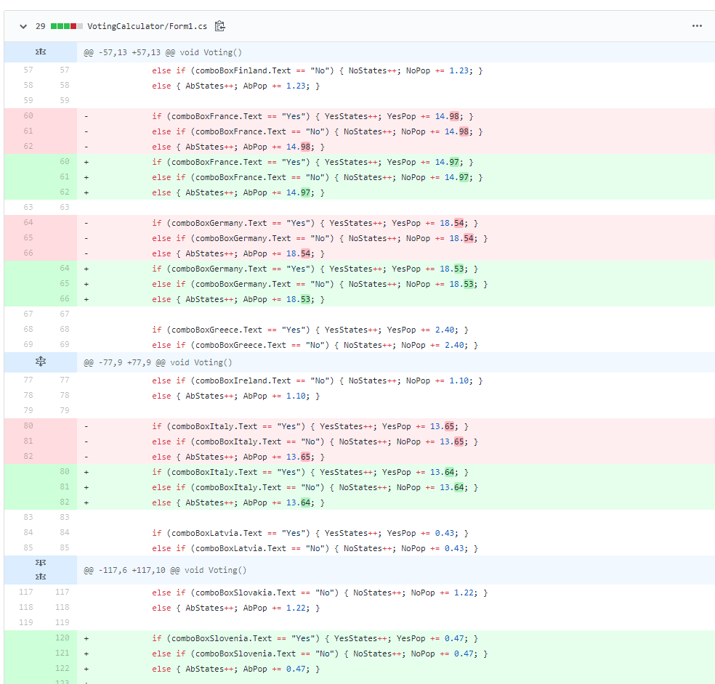
When files were “pushed” to the remote repository the changes made in that commit were shown. This allowed everyone to see who updated the file and what was updated in the file.
Even the smallest of changes to the file were checked over to ensure the program would work successfully and the code is as optimised and efficient as possible.

Slide 4
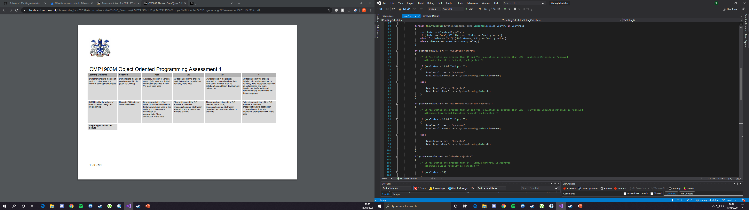
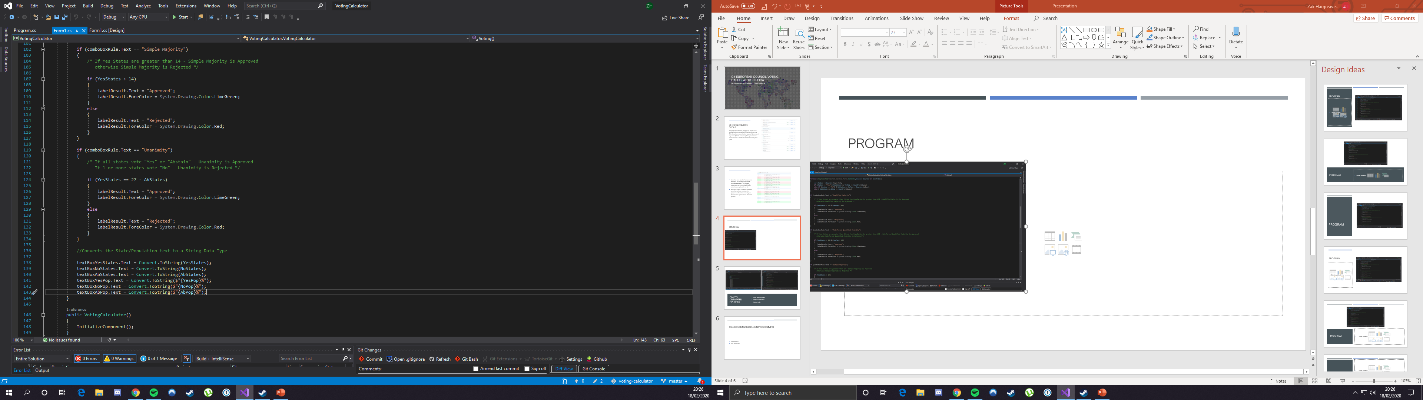
Program
Our program has implemented all the voting rules from the EU Council Voting Calculator: Qualified Majority, Reinforced Qualified Majority, Simple Majority and Unanimity
Each voting rule has different parameters that need to be passed in order for the result to be approved, as seen these parameters were set in the code and adjusted for each voting rule: Qualified Majority needing greater than 15 states and these states need to have a population greater than 65%. If these parameters are passed then the result is approved. Otherwise, the result will be Rejected

Slide 5
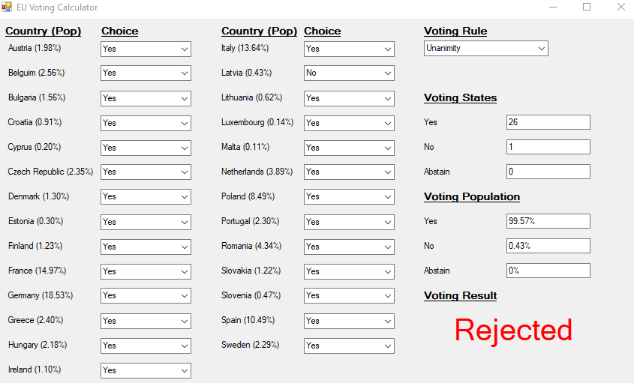
This is the replica of the voting calculator presented in a Windows Form presentation
Each country is listed along with their respective population percentage, each country has the choice of Yes, No and Abstain.
The form also displays the Voting States with an active tally on how many countries voted Yes, No or Abstain, along with the voting population with the overall percentage.

Slide 6
Object-orientated features

Slide 7
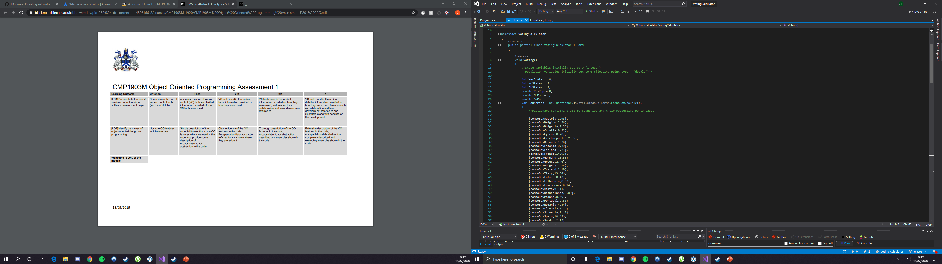
Class implementation
In our code the class was named VotingCalculator : Form. The class had a public access modifier so any class can use or create an instance of this class. Within this class held all the code for the Voting Calculator Form. The class was declared within the namespace ‘VotingCalculator’.

Slide 8
Object instantiations
In our code we have an object instantiation that takes all the EU countries into a Dictionary along with the countries' population which is stored as a ‘double’. This data is then used for the Form where the ‘comboBox’ is the ‘Box’ where each of the countries are on the form.

Slide 9
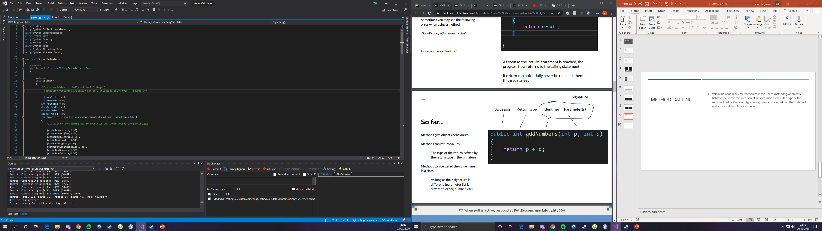
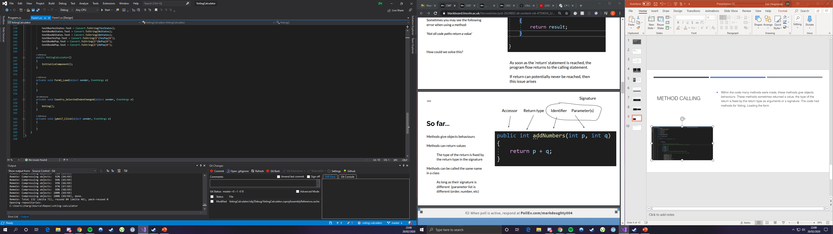
Method Calling
Within the code many methods were made, these methods give objects behaviours. The screenshots show that the first method created “Voting()”, doesn’t have any arguments as no value is being returned, this method holds all the data including the dictionary of all the countries, state variables and all the If/Else conditions. One of the methods below in particular calls the method “Voting” which doesn’t return any values. Once called this method runs all of the data within it.

Slide 10
Object-orientated design/programming

Slide 11
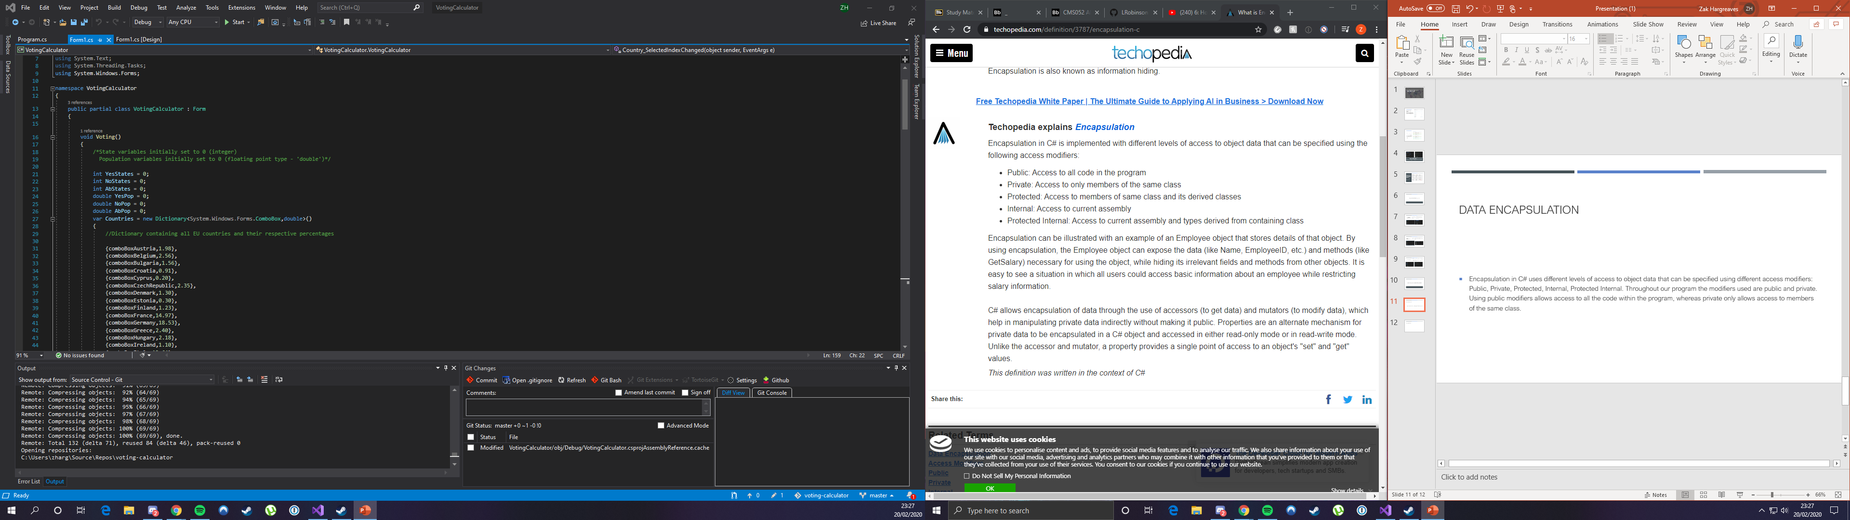
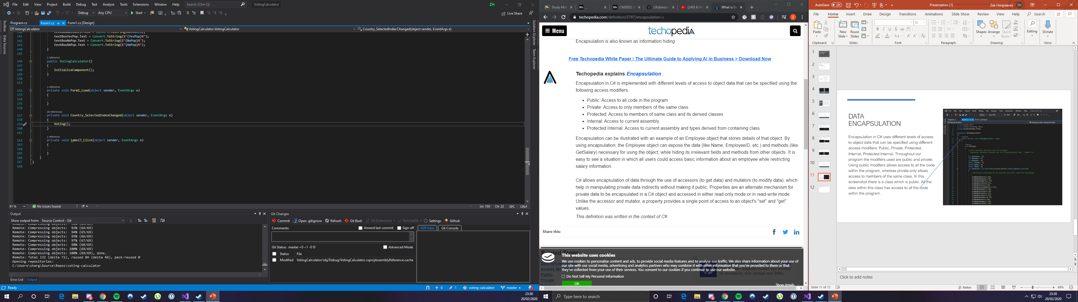
Data encapsulation
Encapsulation in C# uses different levels of access to object data that can be specified using different access modifiers: Public, Private, Protected, Internal, Protected Internal. Throughout our program the modifiers used are public and private. Using public modifiers allows access to all the code within the program, whereas private only allows access to members of the same class. In this screenshot there is a class which is public. All the data within this class has access to all the code within the program. The other screenshot shows a private method but within this private method is another method that has been called “Voting”. This method is public therefore is can be used anywhere in the program, even methods that are private.

Slide 12
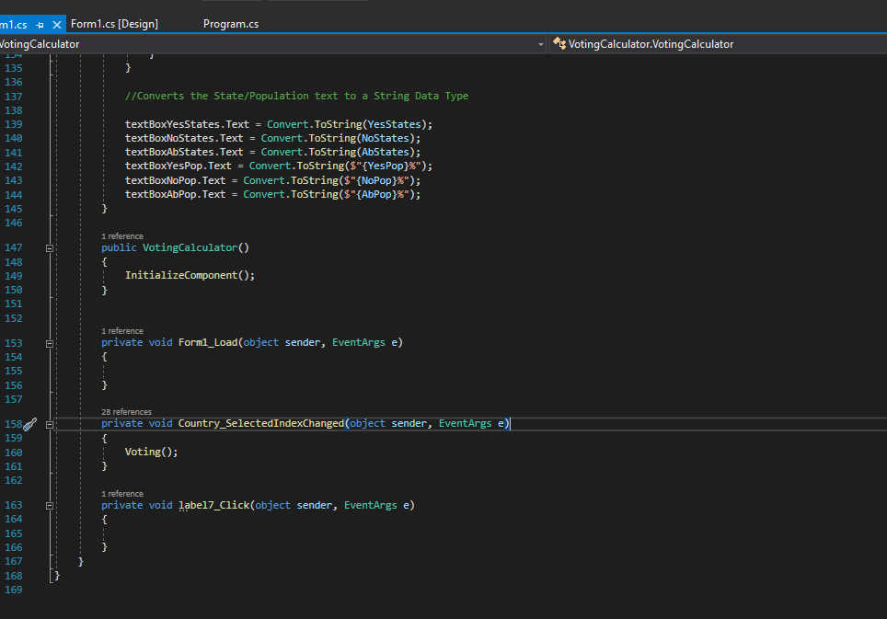
Data abstraction
The principle behind data abstraction is to hide implementation details of a class and use access modifiers to hide and make necessary methods and fields public
In this screenshot of the code there are private methods which abstracts functionality away from the user. The three private methods cannot be altered by the user when the program is running.

